Slide 1

LEAVE MANAGEMENT SYSTEM(LMS)
Muhammad Afif Mirza bin Mohd Farid 192128
Amir Khaidir bin Adzeman 192212
Noraein binti Sabtu 192661
Anis Nur Hajar binti Ahmad Rizal 192560
Nur Aida Farahanie binti Ahmad 192494

Slide 2





OUR TEAM ORGANIZATION
AFIF MIRZA
(PROJECT MANAGER)
AMIR KHAIDIR
(PROGRAMMER)
NORAEIN
(PROGRAMMER)
AIDA FARAHANIE
(SOFTWARE DESIGNER)
ANIS NUR HAJAR
(SOFTWARE TESTER)

Slide 3
ABOUT OUR PROJECT
System scopes:
LMS is server-based application(BRINFO SYSTEM)
Developed to ease the organization in managing the employees’ leave recording
LMS is used to record and manage the leaves applied by the employees
User scope involved:
Employees
System Administrator

Slide 4




PROBLEM
SOLUTION
The Human Resource Department wanted the Leave Management System (LMS) to be updated so that it can ease the employees to apply their leave efficiently
We discussed with the Brinfo IT department on developing the new Leave management System (LMS) using Visual Studio IDE and ASP.NET Core MVC in C# language

Slide 5
OUR OBJECTIVES
IMPROVISATION
USABLE
To improvise the current LMS based on client’s needs
To achieve usability standard in the system

Slide 6
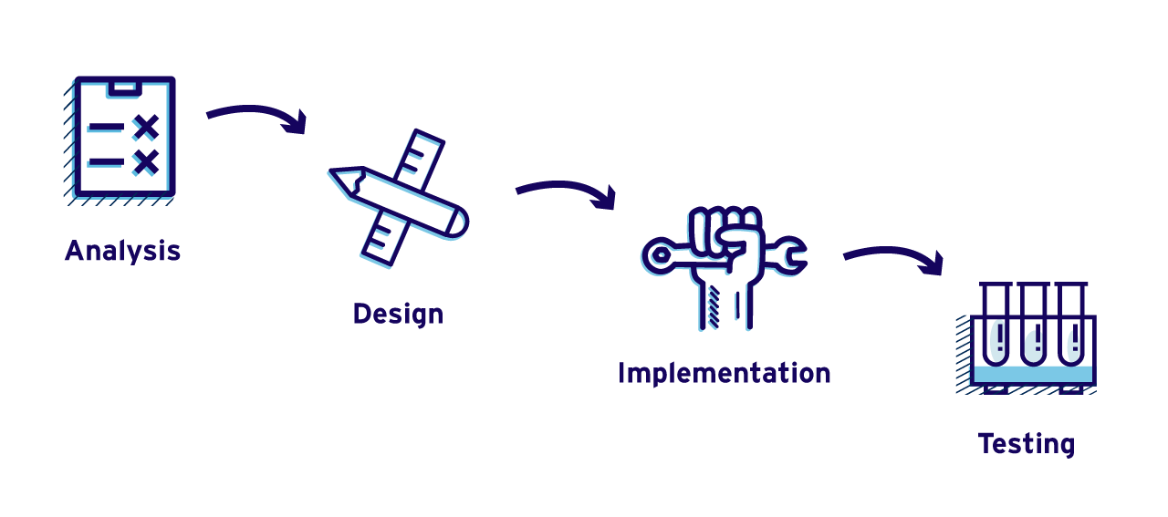
METHODOLOGY
Waterfall methodology
Why?
Simple and easy to understand and use
Works well for smaller projects where requirements are very well understood
Easy to manage due to the rigidity of the model
Notes:
= Easy to manage due to the rigidity of the model as each phase has specific deliverables and a review process.

Slide 7
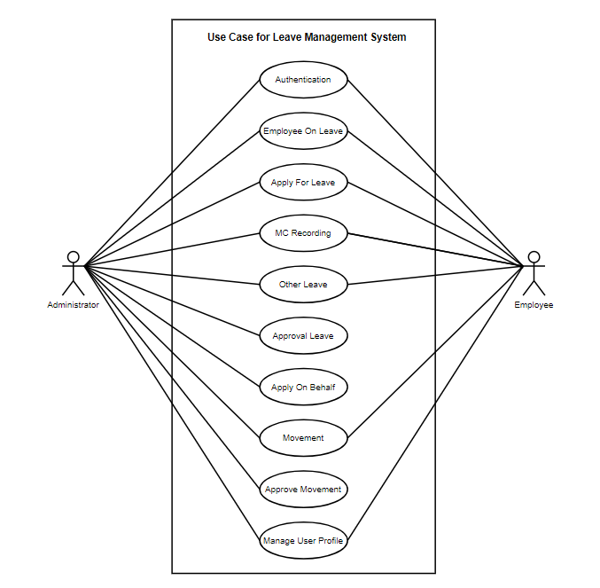

USE CASE FOR LEAVE MANAGEMENT SYSTEM (LMS)

Slide 8
FUNCTIONALITIES
HERE ARE THE FUNCTIONALITIES THAT WE ARE CURRENTLY WORKING ON THE LMS SYSTEM

Slide 9
EMPLOYEE ON LEAVE
APPLY FOR LEAVE
MC RECORDING
OTHER LEAVE
ADMINISTRATOR
MOVEMENT
Viewing all the leaves applied
Apply for leave (emergency and annual leaves)
Apply leave for medical leave
apply other leave type such as maternity or pilgrimage leave
Enable admin to do multiple task on behalf
Insert movement of the outstation employee
Notes:
So, basically the first functionalities that we want to emphasize is the employee on leave functionalities where both sides, admin n also employee can view all the leaves applied. Next, is the apply for leave functionalities is where the employees as well as the admin can apply for leave types such as emergency leave or annual leave. Then, we move on tho the MC Recording functionalities where the employee can apply leave for medical leave. nEXT IS THE OTHER LEAVE FUNCTIONALITIeS, where it can enable employee to apply other leave type such as maternity/paternity leave as well as pilgrimage (haji) leave. Then, for the administrator site, we have add a new functionalities on the admin site(which is based on the client’s need and requirement). So we add the apply on behalf tab in the admin site which later we will demo it. And for the movement functionalities, sometimes, the employee need to work outstation, so the employee can insert the movement of itself in this movement tab. Next we move on to the demo of the lms system.

Slide 10

DEMO OF THE SYSTEM

Slide 11

CONCLUSION
Able to develop a Leave Management System using C# language within the time given
Able to improvise the Leave Management System according to client's needs and requirements
Able to improve the teamwork skills by each of the team member in completing the tasks given

Slide 12

THANK YOU!!
Do you have any questions?

